Slide 1
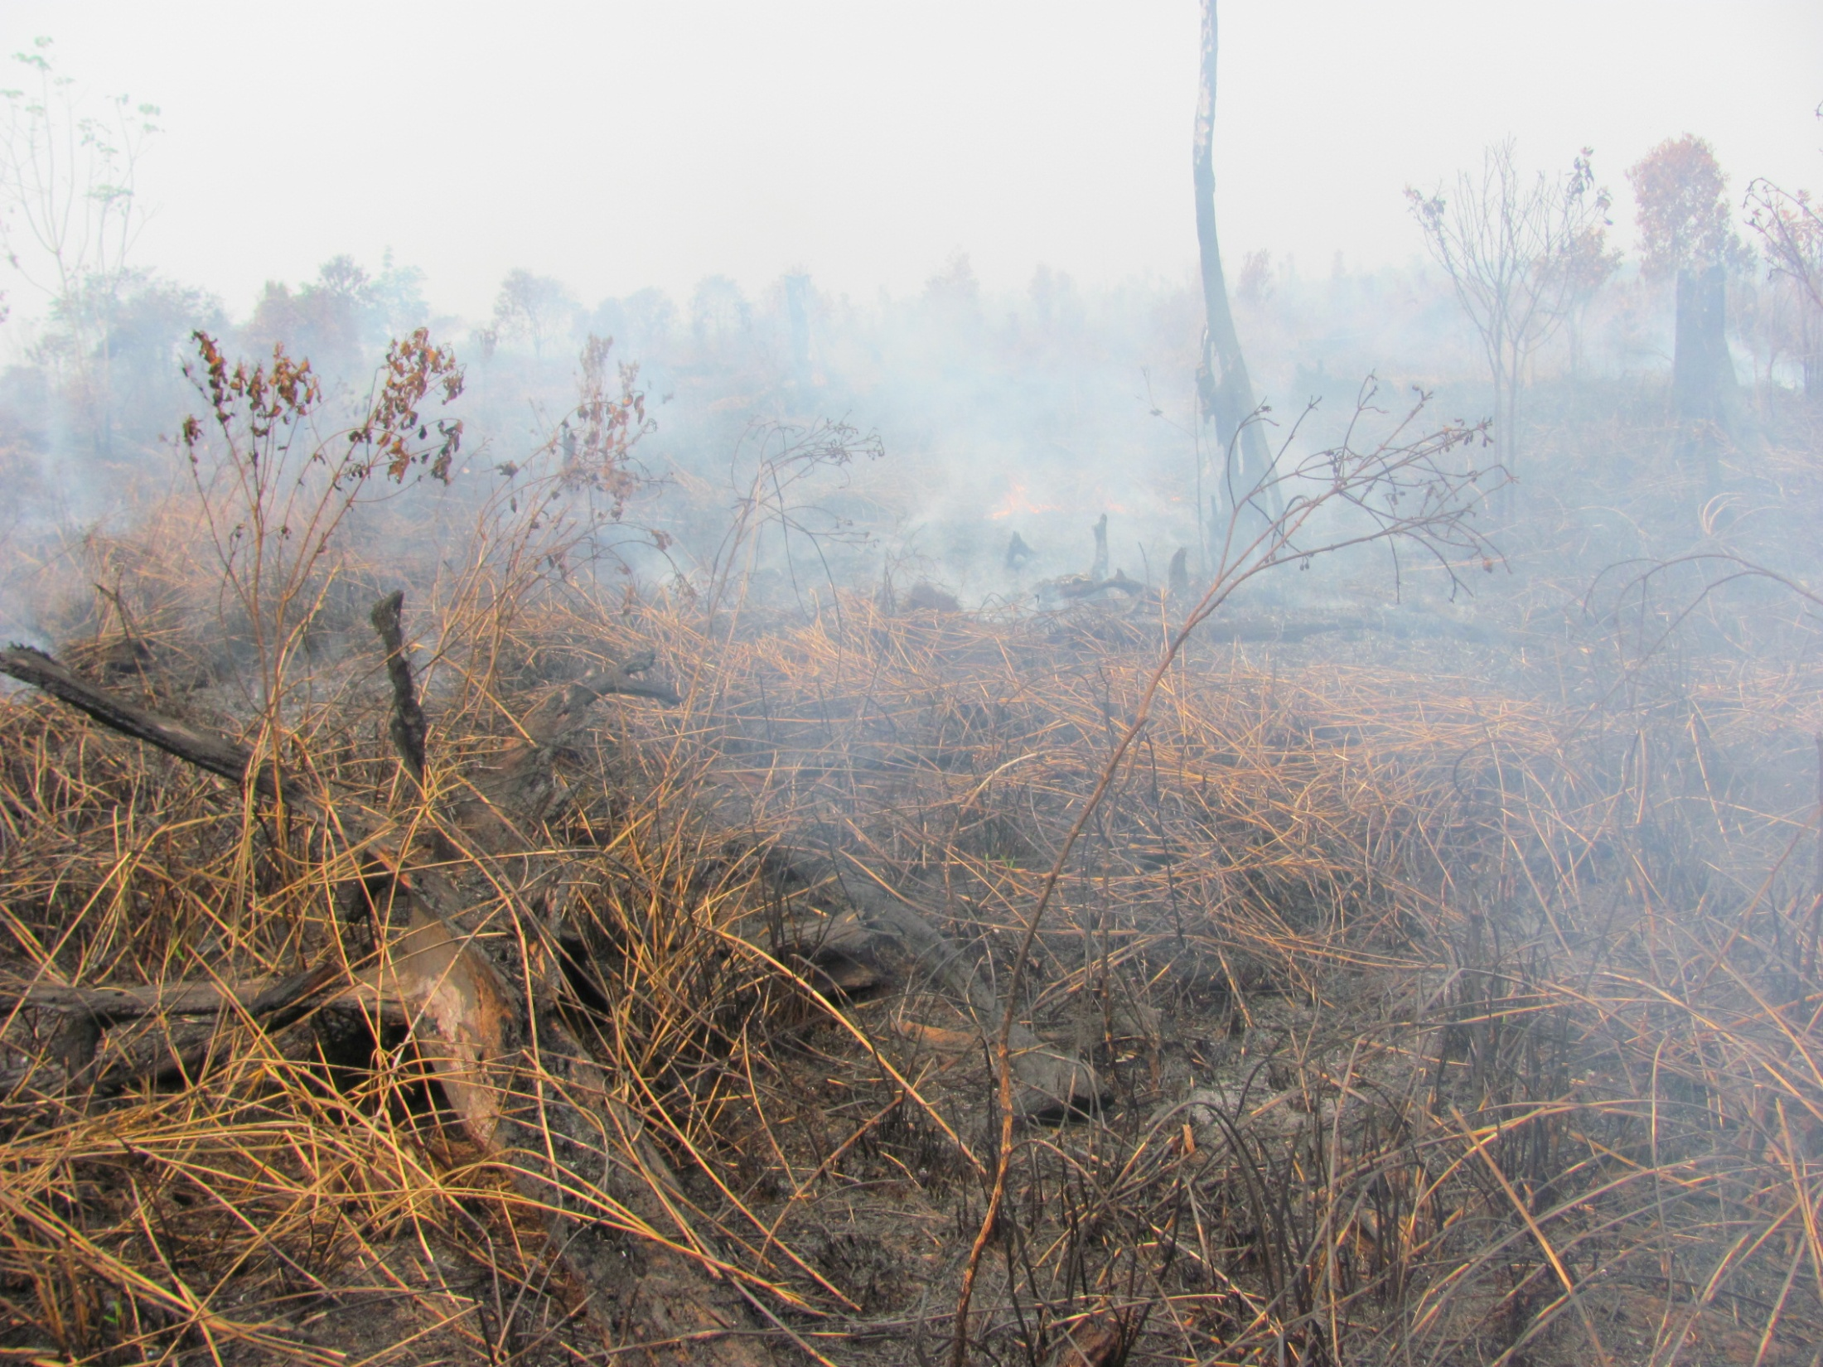
Adding tropical peat-swamp forest fire emissions to Indonesia’s national carbon MRV system
Mark A. Cochrane¹, Bob Yokelson²
¹Geospatial Sciences Center of Excellence
South Dakota State University
²University of Montana
NASA Jet Propulsion Lab
Pasadena, CA – November 6, 2013

Slide 2
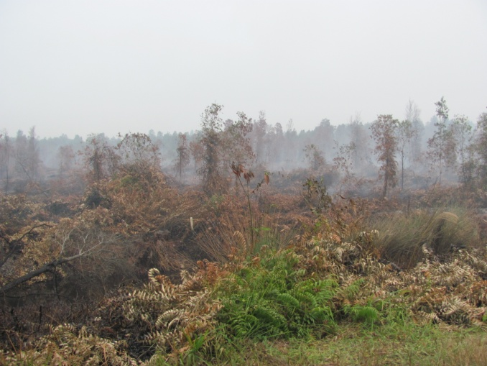
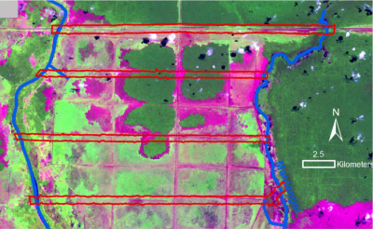
Key Elements
Ex-Mega Rice Project
Reduced Emissions from Deforestation and forest Degradation (REDD+)
(soon to be Ex-) Kalimantan Forest Climate Partnership
Indonesian National Carbon Accounting System (INCAS)

Slide 3
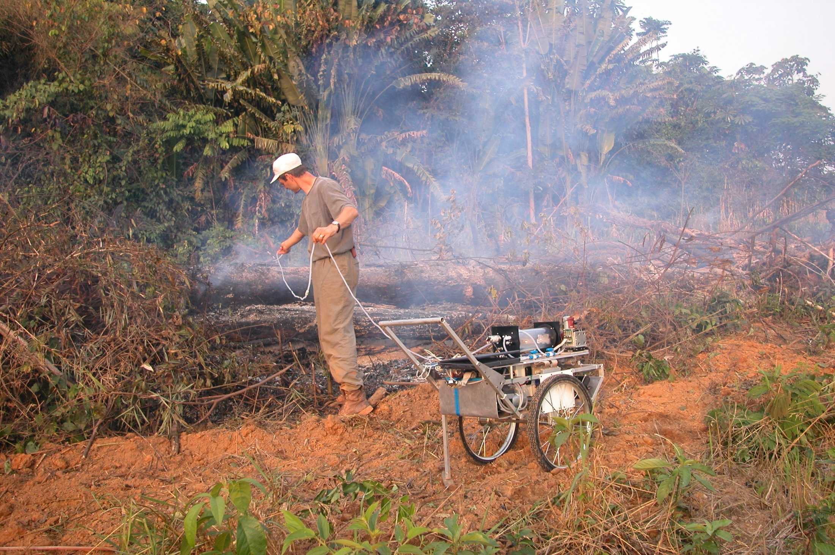
Developing relevant emission factors for the Indonesian Peatlands
~20 Major Gases: HCN, CO, CH4, CO2, NH3, NOx, NMHC, OVOC, HCl, etc
PM2.5 on Filters: EC/OC, metals, tracers, etc

Slide 4
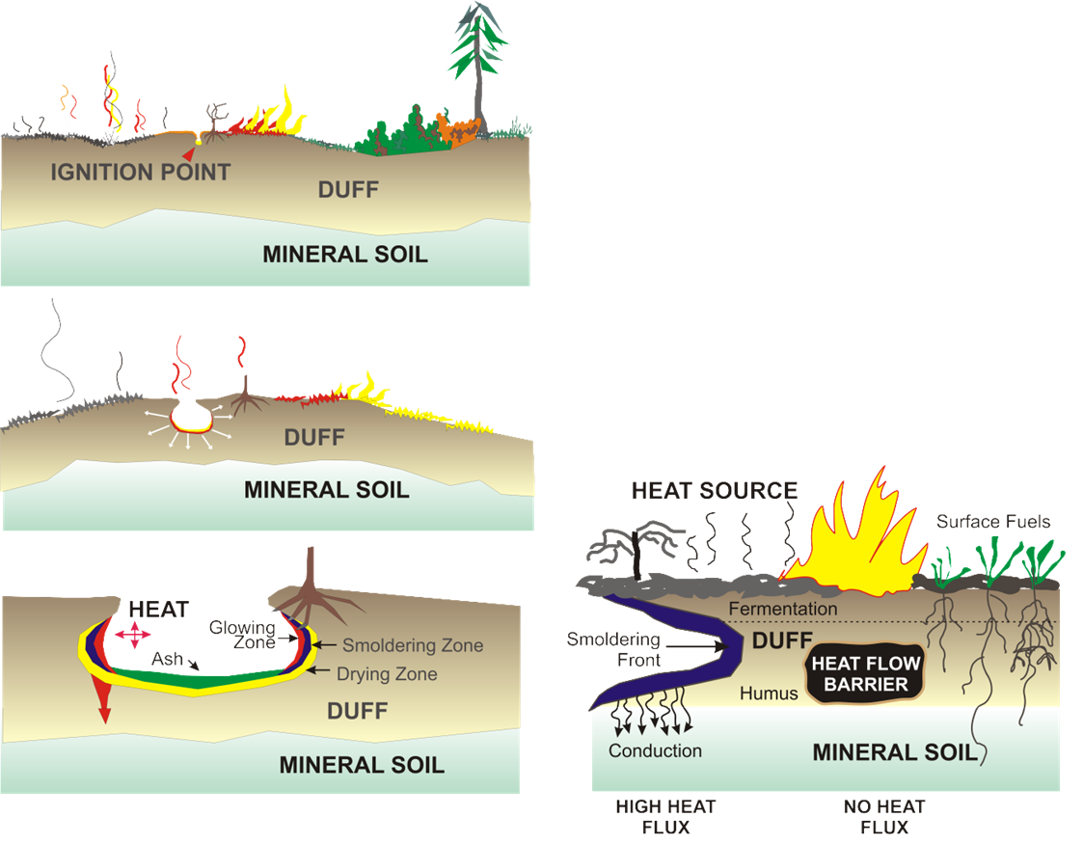
Modeling a dynamic peat fire process
Surface Fires
Ground Fires
Shallow versus Deep Burning

